Slide 1

FY 2018 Analysis and Recommendations
Notes:
Hello and Welcome to …FY2018 Financial analysis…Please feel free to ask any questions that come up throughout this presentation, and I will provide a copy of this slide deck at the end (which is what I would say if I hadn’t linked it ahead of time for the thinkful assignment!

Slide 2
Part one: Overall Analysis

Slide 3
Overall Findings
Notes:
Let’s look at overall findings…healthy profit margin but could be better! I want to explain the expenses figure briefly

Slide 4
Overall Findings - Expenses
Expenses driven by car costs
Because cars move between branches, expenses cannot be calculated per-branch
Accident Expenses currently not tracked
Notes:
Because we don’t track some of this data, we’re lacking some specifics that could be helpful for future analysis. Specifics about accident data would be useful for modeling

Slide 5
Overall Findings - Revenue
Average Revenue Per Branch: $1,056,604

Slide 6
Overall Findings - Revenue
Average Revenue Per Branch: $1,056,604
Number of Branches: 50

Slide 7
Revenue – Branch Performance
Notes:
Note the small spread between branch 10 and branch 1

Slide 8
Revenue – Branch Performance
Notes:
Again, a small spread between the worst performing branch and the 10th worst – they’re all doing well, close to average, and not much difference from the top ten branches

Slide 9
Revenue – Vehicle Performance
Average Revenue Per Car: $13,208

Slide 10
Revenue – Vehicle Performance
Average Revenue Per Car: $13,208
Fleet Size: 4000 Vehicles

Slide 11
Revenue – Vehicle Performance
Expenses driven by car costs
Profit can be calculated on a per-vehicle basis
Notes:
Now what’s interesting about the vehicle data is that we can drill down a little more to look at profit, since our expenses are tracked on a vehicle by vehicle basis – can calculate profit by car

Slide 12
Profit – Vehicle Performance
Notes:
For example, here’s the vehicles that made us the most profit in 2018. This is for all car model years, by specific make and model. This actually isn’t the most useful metric we can use for profit, though, and I’ll get more into that when we look at the model.

Slide 13
Part two: Objectives and Modeling

Slide 14
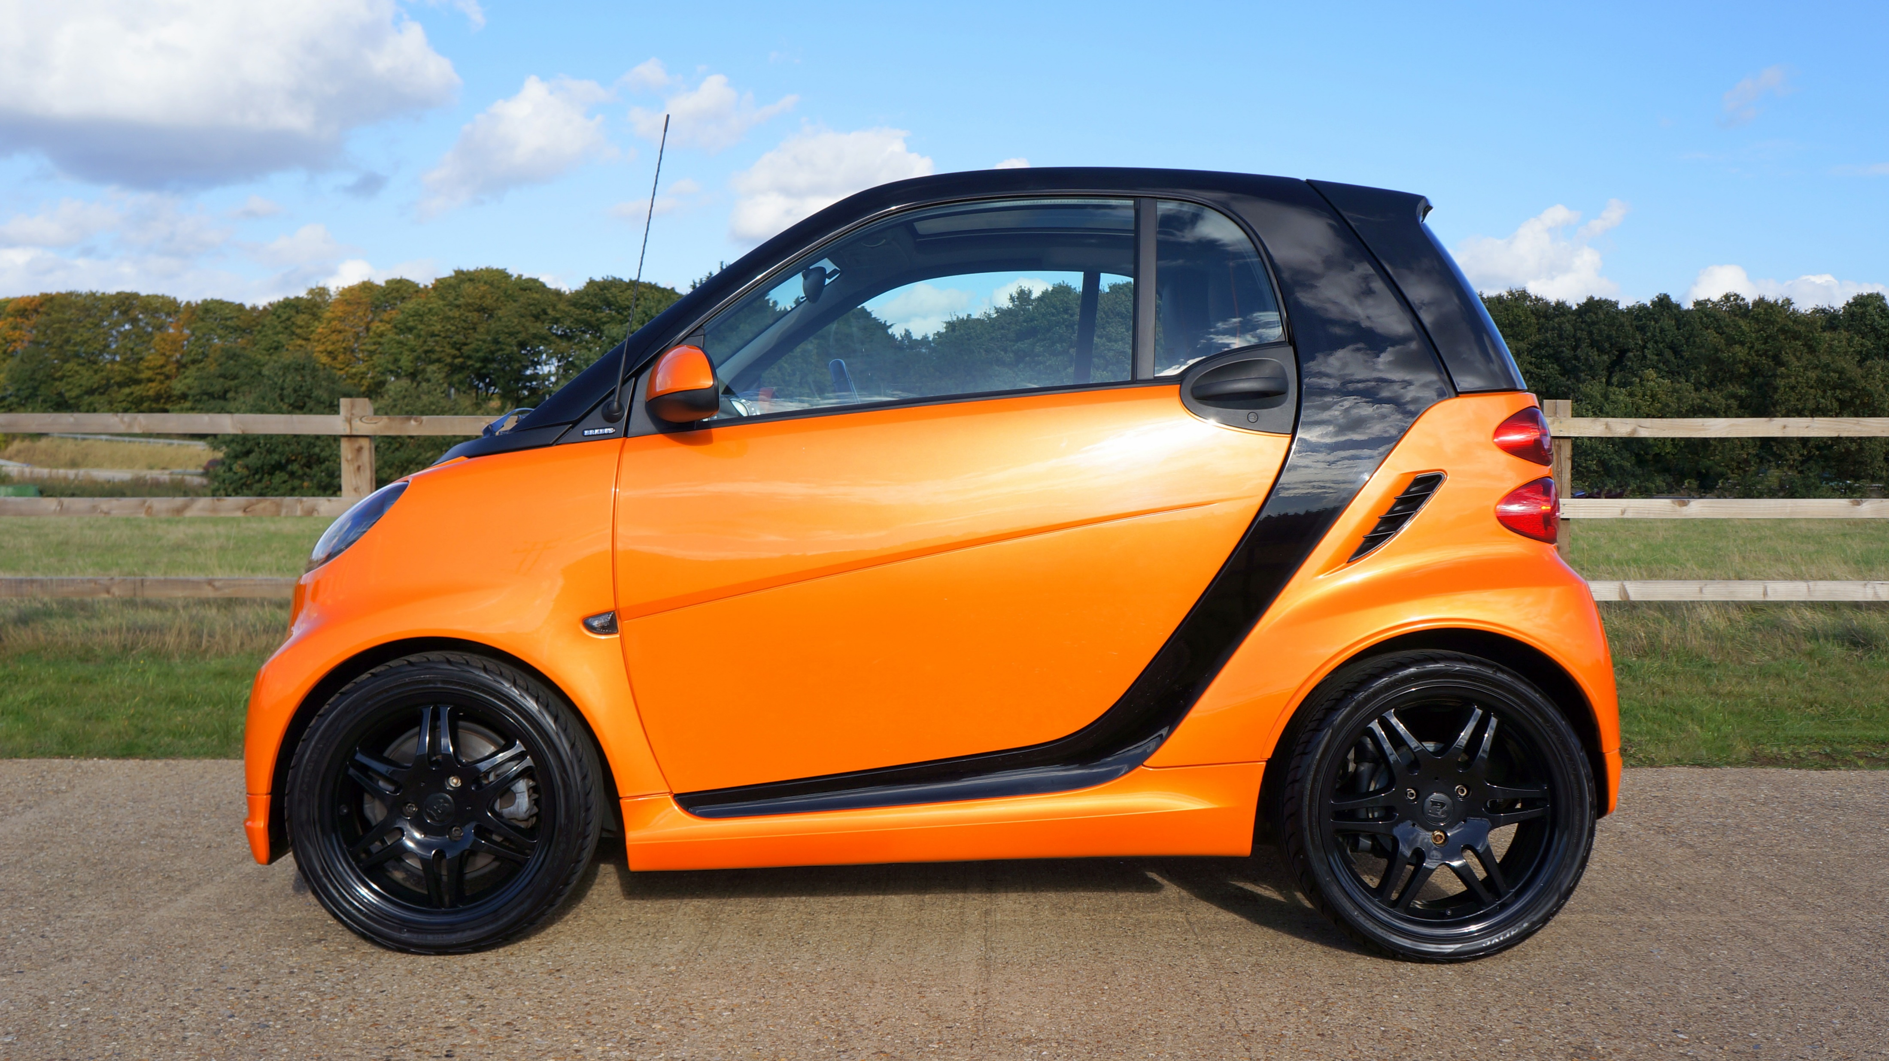
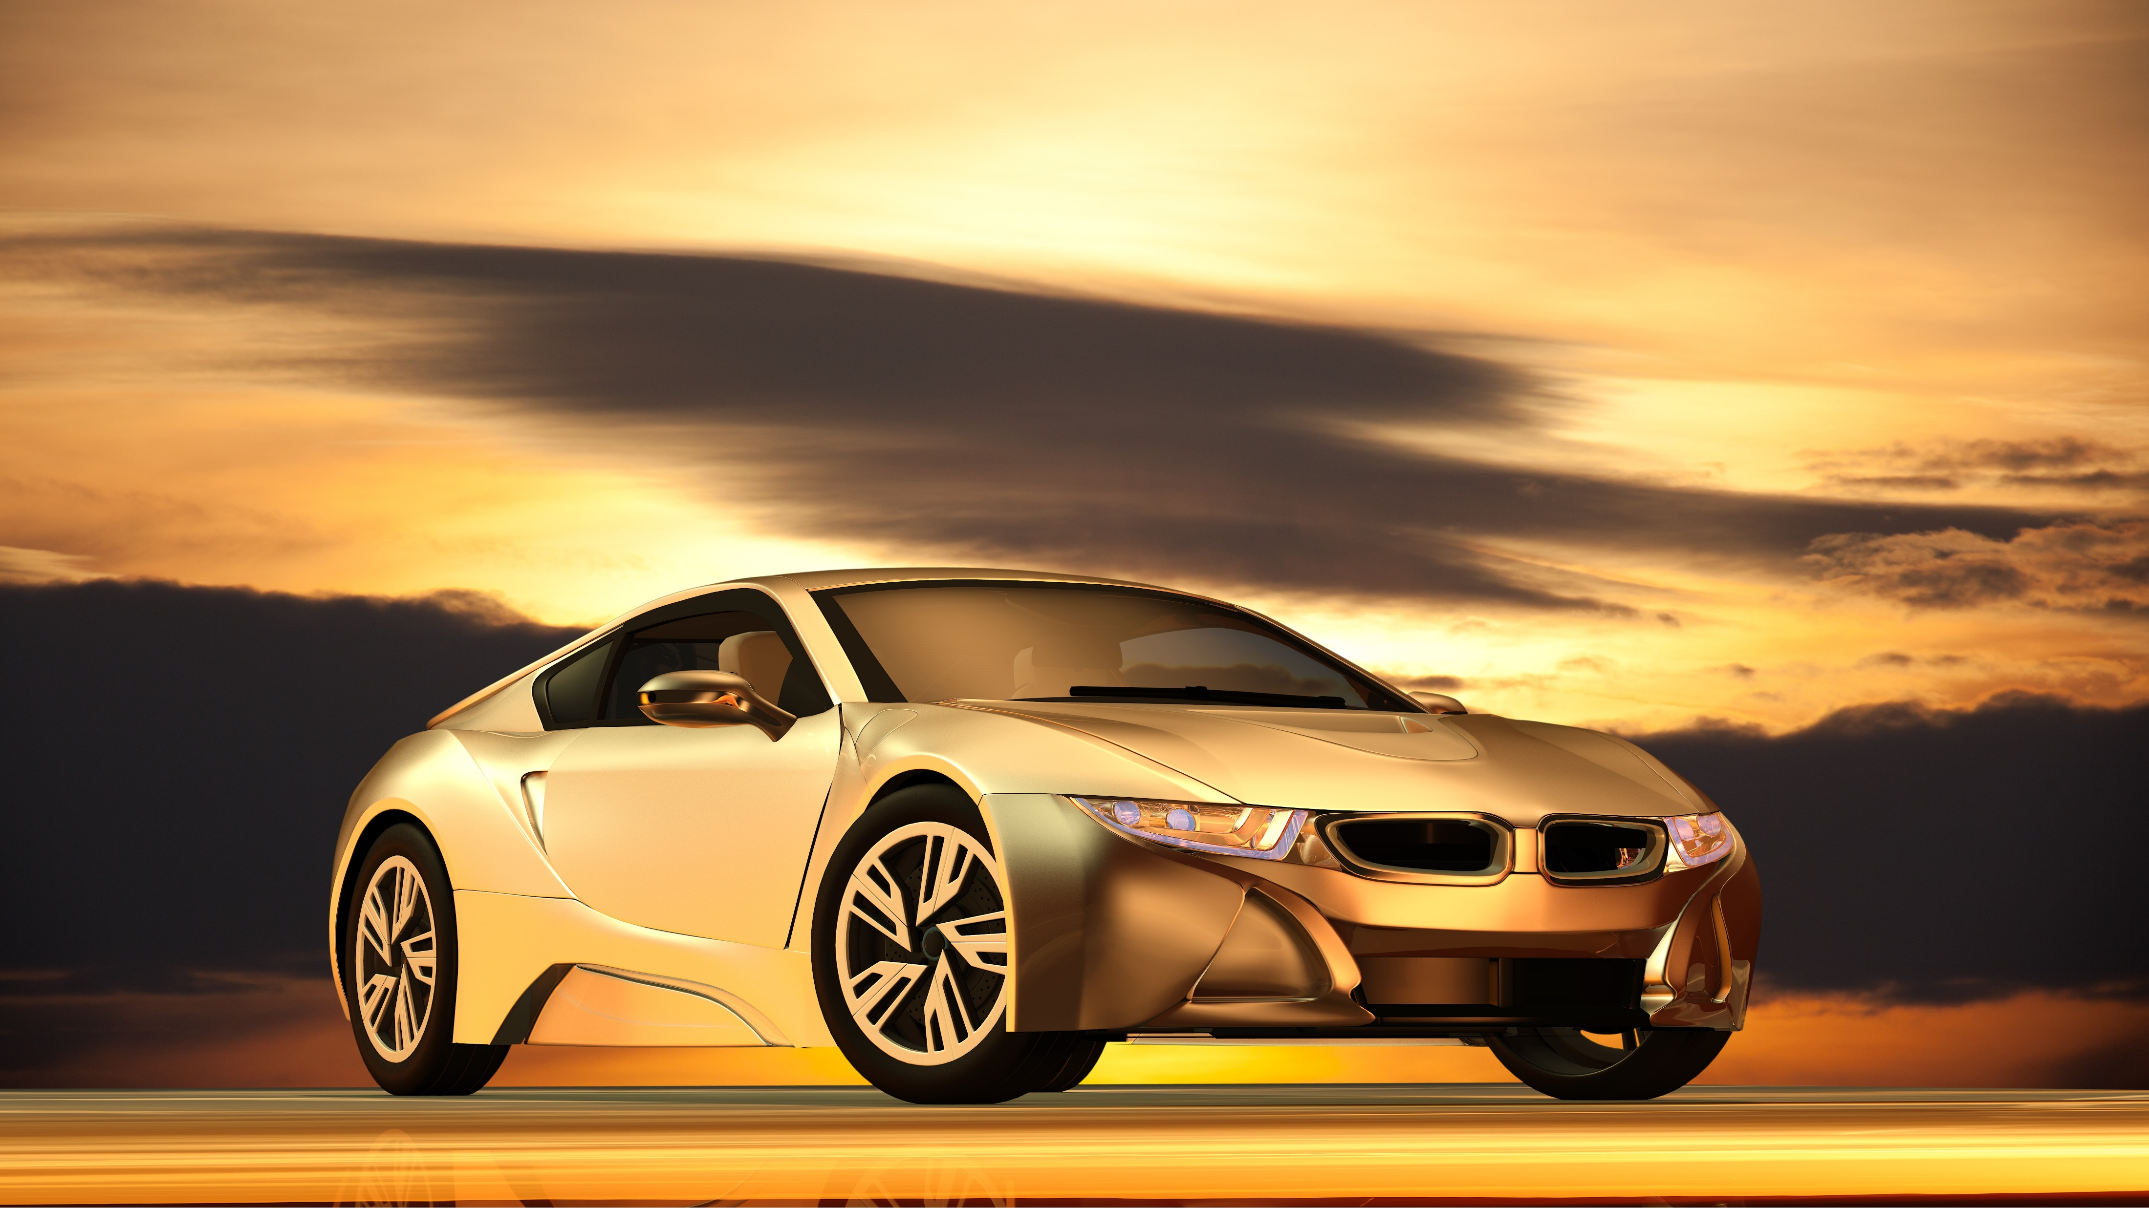

FY 2019 Objective
Discover trends of revenue in:
Overall fleet composition
Individual branch performance
Increase profitability in 2019
Notes:
The more profit, the better!

Slide 15
FY 2019 Objective
How do we best improve?
Three scenarios for projected profit growth

Slide 16
Scenario One: Fleet Composition
Improve efficiency of current fleet
Profit per rental day per car
Notes:
Profit per rental day per car is a great metric to look at efficiency of the fleet, adjusted for number of cars. The problem with that earlier graph we looked at, depicting the most profitable vehicles, is that it’s not adjusted for total quantity of a specific car – so for all we know, we might have 500 of that top-performing Ford 4Runner and that’s why it jumped to the top of that chart.

Slide 17
Scenario One: Fleet Composition
Notes:
So, here we can see the number of vehicles of a particular brand, the bars, compared with the profit per day averaged across the number of vehicles in that brand. If this is confusing and you don’t see any correlations, well…

Slide 18
Scenario One: Fleet Composition
No correlation between profit and number of vehicles!
Notes:
That’s because there is none! No correlation between profit and number of vehicles.

Slide 19
Scenario One: Fleet Composition
Notes:
In fact, if you look at the top ten most profitable makes, there’s actually an inverse correlation with the number of vehicles. This suggests there’s a lot of room for growth in terms of fleet efficiency.

Slide 20
Scenario One: Fleet Composition
2018 Data
Gross Revenue | $52,830,207.00
Gross Expenses | $33,076,688.64
Profit | $19,753,518.36
Average Revenue Per Branch | $1,056,604.14
Number of Branches | 50
Total Car Fleet | 4000
Average Revenue Per Car | $13,207.55

Slide 21
Scenario One: Fleet Composition
2018 Data
Gross Revenue | $52,830,207.00
Gross Expenses | $33,076,688.64
Profit | $19,753,518.36
Average Revenue Per Branch | $1,056,604.14
Number of Branches | 50
Total Car Fleet | 4000
Average Revenue Per Car | $13,207.55
2019 Modeled Data
Fleet Efficiency Growth: | 4%
Fleet Size Growth: | 0%
Gross Revenue | $54,943,415.28
Gross Expenses | $33,076,688.64
Profit | $21,866,726.64
Average Revenue Per Branch | $1,098,868.31
Number of Branches | 50
Total Car Fleet | 4000
Average Revenue Per Car | $13,735.85
Change in Total Profit | $2,113,208.28

Slide 22
Scenario Two: Overall Growth
Add more branches at promising locations
Expect similar performance from existing branches
Notes:
Because of the data we saw earlier, we can expect new branches in underserved locations to perform very similarly to existing branches

Slide 23
Scenario Two: Overall Growth

Slide 24
Scenario Two: Overall Growth

Slide 25
Scenario Two: Overall Growth
Takeaways:
Minor differences branch to branch
Other metrics also show little variance
New branches should hew close to average

Slide 26
Scenario Two: Overall Growth
2018 Data
Gross Revenue | $52,830,207.00
Gross Expenses | $33,076,688.64
Profit | $19,753,518.36
Average Revenue Per Branch | $1,056,604.14
Number of Branches | 50
Total Car Fleet | 4000
Average Revenue Per Car | $13,207.55

Slide 27
Scenario Two: Overall Growth
2018 Data
Gross Revenue | $52,830,207.00
Gross Expenses | $33,076,688.64
Profit | $19,753,518.36
Average Revenue Per Branch | $1,056,604.14
Number of Branches | 50
Total Car Fleet | 4000
Average Revenue Per Car | $13,207.55
2019 Modeled Data
Number of New Branches: | 4
Gross Revenue | $57,056,623.56
Gross Expenses | $35,722,823.73
Profit | $21,333,799.83
Average Revenue Per Branch | $1,056,604.14
Number of Branches | 54
Total Car Fleet | 4320
Average Revenue Per Car | $13,207.55
Change in Total Profit | $1,580,281.47

Slide 28
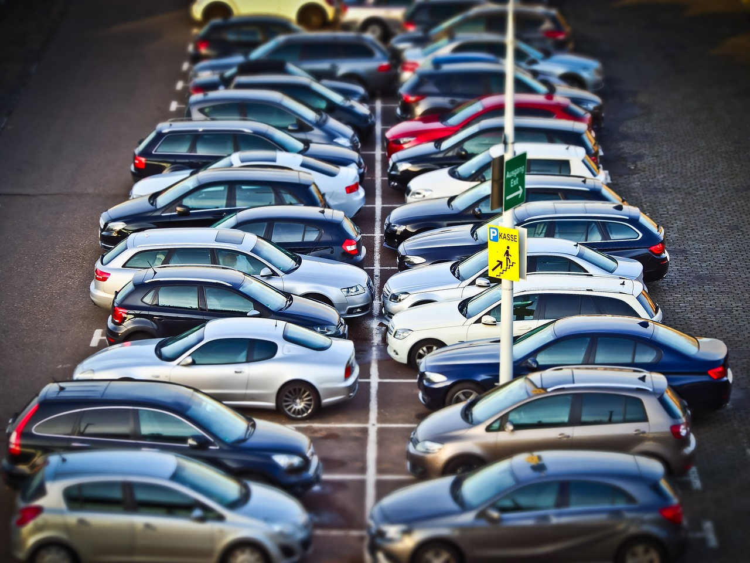
Scenario Three: All of the Above!

Slide 29
Scenario Three
Combine a more cost-efficient and larger fleet with a greater number of branches

Slide 30
Scenario Three
2018 Data
Gross Revenue | $52,830,207.00
Gross Expenses | $33,076,688.64
Profit | $19,753,518.36
Average Revenue Per Branch | $1,056,604.14
Number of Branches | 50
Total Car Fleet | 4000
Avg Revenue Per Car | $13,207.55
2019 Modeled Data – Fleet Growth
Fleet Efficiency Growth: | 4%
Fleet Size Growth: | 0%
Gross Revenue | $54,943,415.28
Gross Expenses | $33,076,688.64
Profit | $21,866,726.64
Avg Revenue Per Branch | $1,098,868.31
Number of Branches | 50
Total Car Fleet | 4000
Avg Revenue Per Car | $13,735.85
Change in Total Profit | $2,113,208.28
2019 Modeled Data – New Branches
Number of New Branches: | 4
Gross Revenue | $57,056,623.56
Gross Expenses | $35,722,823.73
Profit | $21,333,799.83
Avg Revenue Per Branch | $1,056,604.14
Number of Branches | 54
Total Car Fleet | 4320
Avg Revenue Per Car | $13,207.55
Change in Total Profit | $1,580,281.47
Notes:
I just wanted to put this all in one place – this is the data from the two previous scenarios, next to the 2018 data

Slide 31
Scenario Three
2019 Modeled Data – Combined
Fleet Efficiency Growth: | 4%
Fleet Size Growth: | Proportional
Number of New Branches: | 4
Gross Revenue | $59,338,888.50
Gross Expenses | $35,722,823.73
Profit | $23,616,064.77
Average Revenue Per Branch | $1,056,604.14
Number of Branches | 54
Total Car Fleet | 4320
Average Revenue Per Car | $13,735.85
Change in Total Profit | $3,862,546.41
Notes:
And here we have the combined data! Note, again, that I did not model a fleet size increase beyond what is proportional for the new branches, but that is something that you can play around with in the model if you wish.

Slide 32
Summary & Final Recommendation
Significant growth from small changes
Multipronged approach the most effective
Market Research required to intuit demand details
Notes:
Before implementing these plans, we will need to both confirm that increased quantities of the most popular vehicles will not stifle demand, and also ensure that new branch locations are in otherwise underserved areas. That being said, our margins for improvement are significant enough that I have great confidence these strategies can be successful.

Slide 33

Thank you!
Jacob Alex Huerta
10/21/2021

